Slide 1



NET Training
Simplified Acquisition Procedures
(SAP)
Air Force Materiel Command
War-Winning Capabilities … On Time, On Cost
AFFTC/PKC
Mar 12
Integrity ~ Service ~ Excellence

Slide 2
Course Overview
Length – 2 hours
Method of delivery - Presentation
Course contents
  Simplified Acquisition Procedures as described in FAR Part 13 and other references

Slide 3


Overview
Definition
Criteria for Use
Advantages
SAP Methods
Summary

Slide 4

Definition
Simplified Acquisition Procedures (SAP) (formerly referred to as “Small Purchases”) use acquisition methods prescribed in FAR Part 13 for the acquisition of supplies and services including construction, research and development and commercial items, the aggregate amount of which does not exceed the SAT (Simplified Acquisition Threshold; i.e. $150K)¹
FAR 13.000

Slide 5
Definition …
SAPs are contracting methods designed to streamline the acquisition process and facilitate the procurement of goods and services quickly and easily. The results include less paperwork and lower costs for both the contractor and the government.

Slide 6
Definition …
Important SAP Terminology:
  Simplified Acquisition Threshold (SAT):
    $150,000 for non-commercial purchases¹
  Micro-Purchase:
    Purchases which do not exceed the Micro-Purchase threshold
  Micro-Purchase Threshold:²
    $3,000 for Supplies:
    $2,500 for Services
    $2,000 for Construction
¹Note: SAPs awarded in Micro-purchase to $150K range are reserved for Small Businesses
²Contingency Contracting micro-purchase threshold for supplies/services is $15,000 in USA
and $25,000 outside USA

Slide 7
Criteria for Use
Use one of the acquisition methods prescribed in FAR Part 13:
  Government-Wide Purchase Card (FAR 13.301)
  Purchase Orders (FAR 13.302)
  Blanket Purchase Agreements (FAR 13.303)
  Imprest Funds & Third Party Drafts (FAR 13.305)
  SF 44, Purchase Order-Invoice-Voucher (FAR 13.306)
Aggregate amount of acquisition does not [generally¹] exceed SAT (Simplified Acquisition Threshold):
  SAT amount is $150K
  ¹Exception: amount is $6.5M for Commercial Items (FAR 13.500) ¹No longer applicable as of 1JAN2012

Slide 8
Criteria for Use …
Requirement not available through a required source in FAR Part 8
  (e.g., Federal Prison Industries, Committee for Purchase from People Who are Blind or Severely Disabled, and Federal Supply Schedule contracts)
No other procurement instrument is in place to satisfy the requirement (e.g. Indefinite Delivery contract, Other Established Contracts, etc.)
Requirement is well-defined
FAR 13.003(a)

Slide 9
Advantages
Faster than other acquisition methods
  Shorter solicitations
  Faster turnaround times
Saves money for Government and Contractor
  Less paperwork
  Less manpower
  Reduced administrative costs
Promotes Small Business Opportunities
  Acquisitions exceeding Micro-purchase but not over $150K (SAT) are set-aside for Small Businesses (FAR 19.502-2)

Slide 10
Five SAP Methods
Buying Methods Prescribed in FAR Part 13
Government-Wide Purchase Card
Purchase Orders
Blanket Purchase Agreements
Imprest Funds & Third Party Drafts
SF 44, Purchase Order-Invoice-Voucher

Slide 11
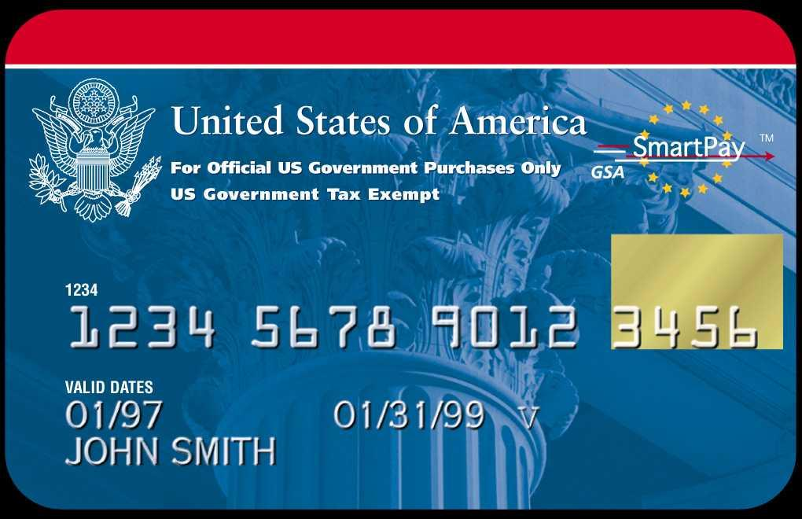
Government-Wide
Purchase Card Program
#1
FAR 13.301

Slide 12

What is the Purchase Card?
Simply put, it’s a VISA card
Contract between GSA and U.S. Bank
Used, primarily, for micro-purchases
  < $2,000 for Construction
  < $2,500 for Services
  < $3000 for Supplies
Pre-priced government contracts are exceptions <$25K

Slide 13

WHAT GOVERNS THE
PURCHASE CARD PROGRAM?
FAR 13.301
GSA CONTRACT (with the Bank)
AFI 64-117- AF Govt-Wide Purchase Card Program
AFI 65-601 v1 - Budget Guidance and Procedures

Slide 14
How-to acquire Micro-purchases without using GPC
AF Policy: A written determination from a member of SES, Flag Officer, or General Officer is required for purchases of Micro-Purchases¹ NOT purchased using the Purchase Card (Ref. 2 Oct 98 memorandum, Subject: Streamlined Payment Practices for Award/Orders Valued at or below the Micro-Purchase Threshold, signed by Dave Oliver, Principal Deputy, Under Secretary of Defense)
¹Micro-purchases:
< $2,000 for Construction
  < $2,500 for Services
  < $3000 for Supplies

Slide 15
Items Typically Acquired
Homeland Defense
Computers, Software and Computer Equipment
Construction < $2000
Office Supplies
Furniture
Electronics
Nonpersonal Services < $2500

Slide 16
Cardholder Expectations of Vendors
Prompt processing of charges
Prompt delivery/service
Quick resolution of problems
FOB destination pricing
Ensuring items are covered by a government contract if purchase exceeds micro-purchase threshold

Slide 17
Cardholder
Responsibilities
Proper Use
Maximizing competition
Fair and reasonable pricing
Training
Tracking delivery and warranty
Follow all simplified acquisition procedures as identified in FAR Part 13
Equipment accountability
Buying “Green”
IRS reporting/withstand audits

Slide 18
Responsibilities of
GPC Team
Billing Official
  Routine oversight of cardholders
Surveillances
  IAW AFI 64-117 Purchase Card Regulation
  Mandatory Sources
  Documentation
  Purchases > Micro-purchase threshold
  Split Purchases
  Abuses

Slide 19
Benefits to Vendors
VISA capable vendors are preferred suppliers
FAST Payment
  Usually 24 hrs
  Maximum 3 calendar days
Bypass invoicing process, thus bypassing DFAS
Dealing directly with end user/customer

Slide 20
E-GPC
AFMC units must obtain office supplies utilizing their GPC only from vendors who offer goods through:
  GSA or AF Advantage (www.afadvantage.gov)
  DoD EMALL (www.emall.dla.mil)

Slide 21
Purchase Orders
#2
A purchase order, when issued by the Government, means an offer by the Government to buy supplies or services, at the stated price in the order and upon specified terms and conditions contained in the order
  Award amount is < Micro-purchase Threshold and < $150K (SAT)
    Unless commercial < Micro-purchase Threshold to <=$6.5M
  Purchase Order itself shall contain at minimum
    Quantities of supplies or scope of services
    Delivery date or period of performance
    F.O.B. destination unless valid reason otherwise
  Usually awarded unilaterally (only CO signs)
  Becomes a binding Contract versus offer when contractor performs or if contractor signs the order
FAR 13.302

Slide 22
Purchase Orders …
Types
  Priced (Preferred)
    Usually Firm Fixed price
  Unpriced
    Price is not set at time of issuance of order
    Impractical to obtain pricing in advance
    See FAR 13.302-2 for restrictions on use
    Monetary limitations shall be placed on the order
      subject to adjustment when price is determined

Slide 23
Purchase Orders …
Solicitation Procedures
  - Oral
    Noncomplex buys
    Acquisition does not exceed SAT
    Only when buy excepted from synopsis requirement
  - Written
    SOW or special clauses are necessary
    Oral quotes are not economical or practical
    Construction buy > $2,000
    Solicitation Forms
      SF 18, Request for Quotation
      SF 1449, Solicitation/Contract/Order for Commercial Items
      SF 1442, Solicitation, Offer and Award (Construction, Alteration or Repair)
      DD 1155, Order for Supplies or Services
      FAR 13.106-1

Slide 24
Purchase Orders …
Award Forms
  SF 1149 - Solicitation/Contract/Order for Commercial Items
  DD 1155 – Order for Supplies or Services
  SF 1442 - Solicitation, Offer and Award (Construction, Alteration or Repair)
      FAR 13.307

Slide 25
Blanket Purchase Agreements
#3
Simplified method of obtaining anticipated repetitive needs for supplies and services by establishing “charge accounts¹” with qualified sources of supply
  Initiated for a broad class of goods or services that are generally purchased but exact items, quantities and delivery requirements are not known
    Sample supplies and services that could be purchased with individual BPAs
      Electrical supplies
      Office supplies
      Boiler Water Treatment Services
      Port-a-potty Services
May award to multiple contractors²
Orders are placed through “Calls” to Contractor
  Verbal or written
    Centralized (Contracting Office)
    Decentralized (customer) if authorized
--------------------------------------------------------------------------------------------------------------------------------
¹Charge Account – A credit arrangement in which a customer receives purchased goods or services before paying for them (i.e. no up-front obligation (PR))
²Multiple Award BPAs - buying office must develop and document a game plan on how orders will be fairly distributed among
awardees (e.g. based upon rotation, lowest price, delivery times, etc.)
      FAR 13.303

Slide 26
Blanket Purchase Agreements …
NOTE
  There are two types of BPAs:
    “Traditional” BPA
      Subject to FAR Part 13
    GSA Schedule BPAs
      Aka Multiple Award Schedule (MAS) BPAs
      Subject to FAR 8.405-3
      FAR 13.303-2

Slide 27
Blanket Purchase Agreements …
  BPA Forms
    - SF 1449, Solicitation/Contract/Order for Commercial Items, or
    - DD 1155, Order for Supplies or Services
  BPA award itself shall contain, at minimum, the following terms and conditions:
    Description of the Agreement
      General description of supplies or services that will be furnished
    - Extent of Obligation
      Govt. is only obligated to pay for actual orders placed
    Authorized “Callers” and their dollar limitation per order (call)
    Delivery Tickets
      Require that deliveries be accompanied with “Sales slips”
    - Invoicing Instructions
    Price List (mandatory for decentralized ordering)
        FAR 13.303-3

Slide 28
Blanket Purchase Agreements …
Orders are placed through “Calls” to Contractor
  Verbal or written
  If not otherwise limited, Individual calls cannot exceed:
    $150K (SAT) – Non-Commercial
    $6.5 M * – Commercial *FAR 13.5 No longer applicable
Government only obligated to pay for placed Orders
Contractor can only take Orders from authorized “callers”
  Callers must keep a log of calls (Call Log)
    What ordered; when ordered; price, etc.
    Reconcile delivered items/services against Call Log
  Some offices prohibit callers from receiving items (check and balance)

Slide 29
Blanket Purchase Agreements …
Ordering (Calls, cont’d)
  Centralized
    “Calls” placed by Contracting Office (Buyer or CO)
      Items do not have to be pre-priced in award
        Fair and reasonable price needs to be determined and documented when ordering
  Decentralized
    “Calls” placed by functional organization (the customer)
      Items or services are pre-priced (Price Lists)
        Negotiated price list are established up-front with award
        Price lists are renegotiated at various agreed upon time intervals (e.g. 1 yr)
      Customer can only order from the price list
    Annual CO review of BPA calls/procedures/documentation required
        IG 5313.303-3

Slide 30
Imprest Funds & Third Party Drafts
#4
Imprest Funds and Third Party Draft payment methods
  Used in rare circumstances where Electronic Funds Transfer (EFT) method of payment is waived for:
    National Security
    Military Operations
    Natural Disasters
    Foreign Government does not support EFT payment
Imprest Funds
  Cash payments
    <=$500 unless other amount is authorized by Agency Head
Third Party Draft
  Check-like payments
    <=$2,500 unless authorized at a higher level in accordance with Treasury restrictions
FAR 13.305

Slide 31

Imprest Funds & Third Party Drafts…
An imprest fund is a fixed-cash or petty-cash fund in the form of currency or coin that has been advanced as Funds Held Outside of Treasury. The imprest fund cash is charged to a specific appropriation account by a Government agency official to an authorized cashier for cash payment or other cash requirement as specifically authorized. The fund may be of a revolving type, replenished to the fixed amount as spent or used, or may be of a stationary nature such as a change-making fund.
Cash please!
o
o

Slide 32
Imprest Funds & Third Party Drafts…
Third party draft - means an agency bank draft, similar to a check, that is used to acquire and to pay for supplies and services.
Third party drafts are check-like payment instruments used by a Federal agency, drawn against and paid by an outside-the-government service provider that may be a financial institution. After the drafts,
which have been furnished by the service provider, are issued by the agency and presented at the service provider’s financial institution, the service provider bills the agency for the amount of the drafts
plus the service fees.

Slide 33
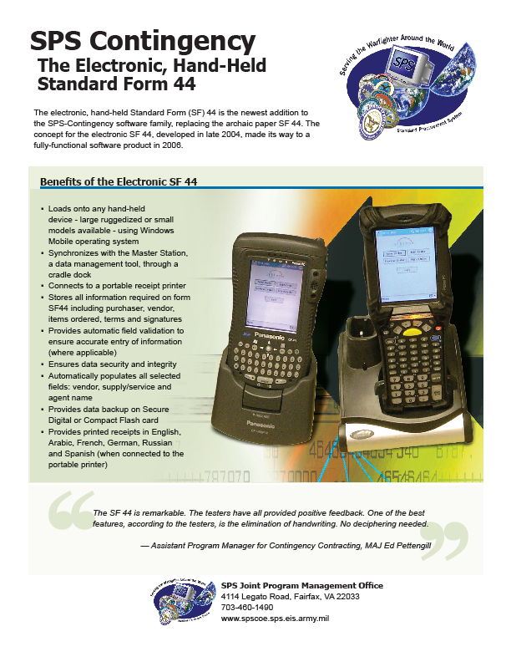
SF 44
Purchase Order-Invoice-Voucher
#5
The SF 44, Purchase Order -- Invoice -- Voucher, is a multipurpose pocket-size purchase order form designed primarily for on-the-spot, over-the-counter purchases of supplies and nonpersonal services while away from the purchasing office or at isolated activities (especially disaster and Contingency operations). It’s an all-in-one document. Can be used as a receiving report, invoice, and public voucher.
Double click on either item to enlarge
FAR 13.306

Slide 34
SF 44
Purchase Order-Invoice-Voucher…
Order NTE Micro-purchase Threshold¹
  unless disaster or contingency buy (<= SAT)
Supplies or services are immediately available
Only one delivery and one payment
No clauses
¹Micro-purchase Threshold:
$2,000 for Construction
  $2,500 for Services
  $3000 for Supplies

Slide 35
Summary
Simplified Acquisition Procedures
  Five (5) Acquisition Procedures prescribed in FAR 13
  For well-defined requirements
  No other procurement instrument in place or mandated to fill requirement
  Faster and more administratively economical than other acquisition methods
  Promote small businesses (SB)
    Full SB set-aside for acquisitions < Micro-purchase to $100K (SAT)

Slide 36
Government-Wide
Purchase Card Program
#1
VISA Card
  Primarily used for micro-purchase buys
  Exception: can be used as payment vehicle on pre-priced govt. contract < $25K where authorized
FAR 13.301

Slide 37
Purchase Orders
#2
A purchase order, when issued by the Government, means an offer by the Government to buy supplies or services, at the stated price in the order and upon specified terms and conditions contained in the order
  Award amount > Micro-purchase and <=$100K (SAT)
    Unless commercial > Micro-purchase and <=$5.5M
  Becomes a binding Contract versus offer when contractor performs or if contractor signs the order
FAR 13.302

Slide 38
Blanket Purchase Agreements
#3
Simplified method of obtaining anticipated repetitive needs for supplies and services by establishing “charge accounts” with qualified sources of supply
Initiated for a broad class of goods or services that are generally purchased but exact items, quantities and delivery requirements are not known
Orders are placed through “Calls” to Contractor
  Verbal or written
    Centralized (Contracting Office)
    Decentralized (customer) if authorized
FAR 13.303

Slide 39
Imprest Funds & Third Party Drafts
#4
Used in rare circumstances where Electronic Funds Transfer (EFT) method of payment is waived
Imprest Funds
  Cash payments
    <=$500
Third Party Draft
  Check-like payments
    <=$2,500
FAR 13.305

Slide 40
SF 44
Purchase Order-Invoice-Voucher
#5
The SF 44, Purchase Order -- Invoice -- Voucher, is a multipurpose pocket-size purchase order form designed primarily for on-the-spot, over-the-counter purchases of supplies and nonpersonal services while away from the purchasing office or at isolated activities (especially disaster and Contingency operations). It’s an all-in-one document. Can be used as a receiving report, invoice, and public voucher.
  Order NTE micro-purchase
    Unless disaster or contingency buy (<=$100K)
FAR 13.306

Slide 41
Summary
Questions?

Slide 42


